Slide 1
Technical Deep Dive: Creating Apps for the Intelligent Cloud Day 3: Integration, Identity Serveless Code & OSS
<Speaker Name>

Slide 2
Agenda
Integration Scenarios – Services Bus & Azure Logic Apps
Background Jobs/Serveless Code - Azure Functions
Configuring Identity and Access – Azure AD
Developing with OSS – MEAN stack on Azure

Slide 3
Integration Scenarios in the Cloud
Connecting disparate systems that are in different environments
Connecting on-premises systems with cloud systems
Certain systems cannot be moved to the cloud for various reasons
- Compliance
- Cost
- Control
- Existing infrastructure

Slide 4

Service Bus - Introduction
Azure
Service Bus
Relayed Communication
One Way
Request Response
Peer to Peer
Service Bus Relay
Entity 1
Entity 2

Slide 5

Service Bus - Introduction
Azure
Service Bus
Relayed Communication
One Way
Request Response
Peer to Peer
Brokered Communication
Queues
Topics/Subscription
Service Bus Queue
Entity 1
Entity 2

Slide 6
Messaging to/from On-Premise Services
Advantages
Asynchronous processing
Reliability (due to persistent nature of queues)
Better scalability (load balancing / load leveling in nature)
Disadvantages
Complexity of asynchronous processing
Bigger development & architecting effort
Might not fit for every use case

Slide 7



Service Bus – Sample Scenario
Scenario
Need: Display on premise data from off premise environment.
Display on premise Data
Mobile App
On Premise

Slide 8

Service Bus – Sample Scenario
Scenario
Solutions:
Reverse publish data using a web site.
Reverse publish via a web service.
Display on premise Data
Mobile App
On Premise

Slide 9

Service Bus – Sample Scenario
Scenario
Candidate Solutions:
Develop a REST service on top of on premise data.
Publish it for external access using Azure Service Bus
Display on premise Data
Azure SB
Mobile App
On Premise

Slide 10





Logic Apps - Intro
FTP Connector
FTP Server
(1) Fetch data from FTP
Receive Request
Invoke Workflow
(2) Insert into SQL
SQL Connector
Web App
WebHooks
Logic App (Hosted Workflows)
(3) Send EMail
SMTP Connector
SMTP Server

Slide 11
Web hook triggers
Native support for triggering via WebHooks, including the ability for you to define a synchronous response to the trigger. This new feature includes:
Static endpoints, which are maintained across resource moves or subscription moves.
Full access to all of the headers and body of the trigger's request.
- By having full access to the trigger's request, you can pass binary or XML content into a Logic app.
SAS style authentication.
- You don't need to use Basic authentication anymore; you can paste the link and it'll automatically work.

Slide 12



Hybrid through Azure App Service
API App (Custom Logic)
On-Premise
Logic App (Your Workflow)
Hybrid Connection Manager
File Server

Slide 13



Hybrid Cloud with Service-Relay Adapters BizTalk Hybrid Connections
Corporate Network
Microsoft SQL Server
Web Sites
Other published resources
Hybrid Connection
Hybrid Connection Manager
Mobile Services

Slide 14
DEMO

Slide 15
Configuring Identity and Access – Azure AD

Slide 16

Azure AD - Intro
Azure AD
Connect
Self-service
Single sign on
Windows Server
Active Directory
Username
•••••••••••
Other Directories
SaaS
Azure
Public
cloud
Office 365
On-premises
Cloud
Microsoft Azure Active Directory

Slide 17
Azure AD – Authentication scenarios Browser to web app – App Service Authentication Web app to web API Multi-tenant web app Native app to web API

Slide 18
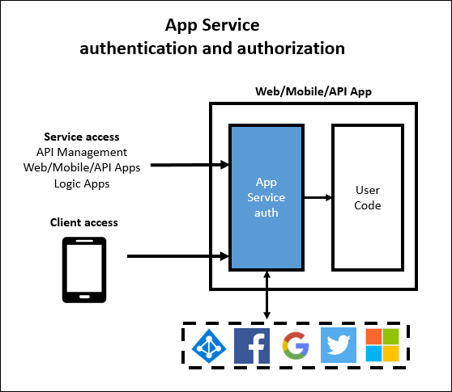
App Service Authentication

Slide 19
DEMO – App Service Authentication

Slide 20
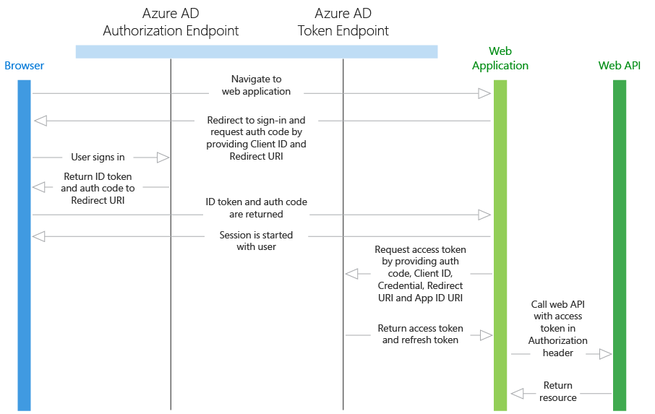
Authenticate users to web app and API using Azure AD

Slide 21
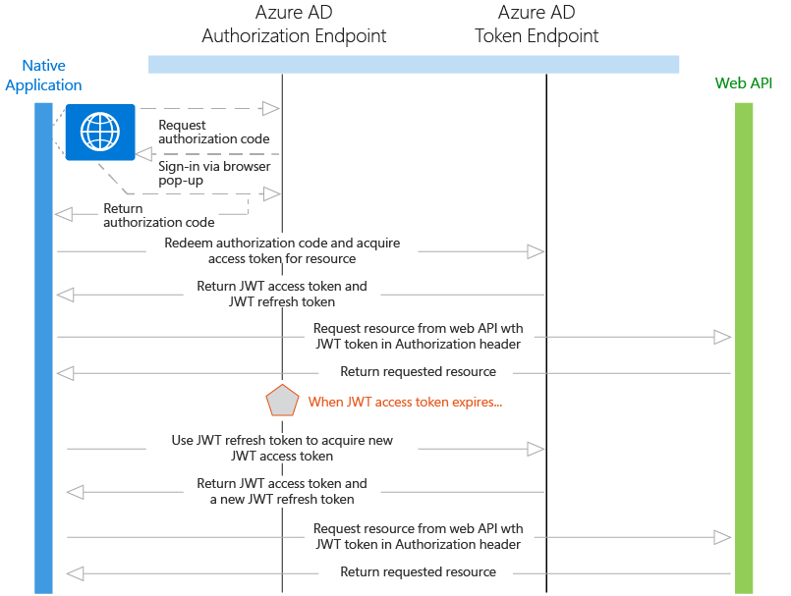
Native App to Web API Authentication

Slide 22
DEMO – Web App and Native App consuming a Web API

Slide 23
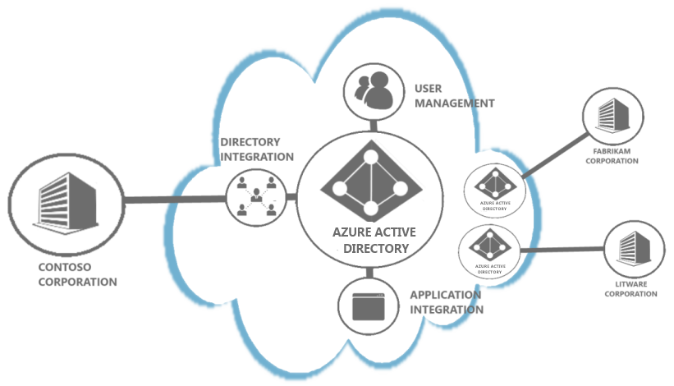
Multi-tenant Azure AD Authentication
https://login.microsoftonline.com/common/

Slide 24
DEMO – Multi-Tenant web app authentication

Slide 25
Building with Open Source Software – MEAN stack on Azure

Slide 26
OpenSource : MEAN Stack
Do you know what I MEAN?
What is MEAN? | Integrating MongoDB
Intro to Angular.js | Tying things together - Demo
Node and Express | Deployment & Conclusion

Slide 27
Why use the MEAN stack?
One language to rule them all
ALL open source
Huge module library
Get started quickly

Slide 28

AngularJS
Our app’s entire front end
Open source, maintained by Google
Client side MVC (MVVM) framework
Excellent data bindings
Easy to test

Slide 29
Where to get Angular?
https://docs.angularjs.org/misc/downloading
Extremely lightweight – download/include only what you need
angular.js
angular-route.js
angular-resource.js

Slide 30

Node.js
Lightweight web server
Built on Google Chrome’s V8 Javascript Engine
Extremely lightweight and efficient
var http = require('http');
http.createServer(function (req, res) {
res.writeHead(200, {'Content-Type': 'text/plain'});
res.end('Hello World\n');
}).listen(1337, '127.0.0.1');
console.log('Server running at http://127.0.0.1:1337/');

Slide 31
How to install Node.js
http://nodejs.org/download/
Prebuilt installers for Windows, OSX
Option to build form source

Slide 32

Express
Creates our routes and our API
“minimal and flexible node.js web application framework”
Abstracts away a lot of low level logic (e.g. for HTTP requests)
Helps organize your Node app into an MVC structure

Slide 33
How to install Express
After node installation:
npm install –g express

Slide 34

MongoDB
The top NoSQL Database
Open Source, maintained by MongoDB (formerly 10gen)
JSON like syntax
Key-value stores
Where to download and install Mongo
http://www.mongodb.org/downloads

Slide 35
Different ways of configuring MongoDB
Standup your own MongoDB server via VMs (IaaS)
Use a service such MongoLab which provides fully managed MongoDB database (PaaS)

Slide 36
Setting up MongoLab Database
Allows for fully managed database
No need to worry about updating/patching MongoDb
Scaling and backups handled for you

Slide 37
Deploying Your MEAN App
Creating an Azure Website
Using git deploy for Continuous Delivery
Configuring environment variables for your app

Slide 38
Other Great MEAN Tools
Yeoman Generator
Grunt
Bootstrap
Mocha & Protractor.js

Slide 39
Azure Functions

Slide 40



What is Azure Functions?
Code
Azure Functions
Events + data

Slide 41
Demo: hello world

Slide 42
What I can do with Azure Functions?
Azure Functions is a great solution for processing data, integrating systems, working with the internet-of-things (IoT), and building simple APIs and microservices.

Slide 43
Features
Choice of language
Pay-per-use pricing model
Bring your own dependencies
Integrated security
Simplified integration
Flexible development
Open-source

Slide 44
Supported Languages
1st class support
Node/JavaScript
C#
Experimental support
F#
Python
PHP
Batch
Bash
PowerShell

Slide 45
Supported bindings
Type | Service | Trigger | Input | Output
Schedule | Azure Functions | ✔
HTTP (REST or WebHook) | Azure Functions | ✔ |  | ✔
Blob Storage | Azure Storage | ✔ | ✔ | ✔
Queues | Azure Storage | ✔ |  | ✔
Tables | Azure Storage |  | ✔ | ✔
Tables | Azure Mobile Apps Easy Tables |  | ✔ | ✔
No-SQL DB | Azure DocumentDB |  | ✔ | ✔
Streams | Azure Event Hubs | ✔ |  | ✔
Push Notifications | Azure Notification Hubs |  |  | ✔

Slide 46
Integrations
Azure Functions integrates with a variety of Azure and 3rd-party service:
Azure DocumentDB
Azure Event Hubs
Azure Mobile Apps (tables)
Azure Notification Hubs
Azure Service Bus (queues and topics)
Azure Storage (blob, queues, and tables)
GitHub (webhooks)
On-premises (using Service Bus)

Slide 47
Reference

Slide 48
Contact Us Technical services to help you win more deals, accelerate deployment and increase consumption
Microsoft Azure
http://aka.ms/PartnerTechnicalServicesAzure
Microsoft CRM Online
http://aka.ms/PartnerTechnicalServicesCRMOnline
Microsoft Office 365
http://aka.ms/PartnerTechnicalServicesO365
Microsoft Windows 10 and Enterprise Mobility Suite
http://aka.ms/PartnerTechnicalServicesWin10EMS
Learn more about your technical support benefits
http://aka.ms/MySupport

Slide 49

Resources
Azure Service Bus
http://www.windowsazure.com/en-us/documentation/articles/service-bus-dotnet-how-to-use-relay/
http://www.windowsazure.com/en-us/documentation/articles/service-bus-dotnet-how-to-use-queues/
http://www.windowsazure.com/en-us/documentation/articles/service-bus-dotnet-how-to-use-topics-subscriptions/
http://www.windowsazure.com/en-us/documentation/articles/service-bus-dotnet-advanced-message-queuing/
http://msdn.microsoft.com/en-us/library/windowsazure/hh532261.aspx (!!)
Azure Active Directory
http://www.windowsazure.com/en-us/services/active-directory/
http://technet.microsoft.com/en-us/library/jj573653.aspx
http://msdn.microsoft.com/en-us/library/windowsazure/dn151121.aspx
http://msdn.microsoft.com/en-us/library/windowsazure/dn532272.aspx
MEAN Stack on Azure
https://mva.microsoft.com/en-us/training-courses/mean-stack-jump-start-8442?l=eovSb3Vz_4604984382

